Slide 1
NUMBER SYSTEM
EPROG
COMPUTER FUNDAMENTALS & PROGRAMMING FOR ENGINEERING STUDENTS
<<professor>>

Slide 2
Topics
1-1 Introduction to Binary
1-2 Understanding Number System
1-3 Conversion of Number System
Number Systems
Notes:
Problem Solving

Slide 3
Learning Objects
After completing this module that student will be able to :
  Distinguish the different number systems
  Convert from one number system to another
Number Systems

Slide 4
Introduction to data conversion
The study of binary system will help us gain better understanding of how computers perform computation.
Number Systems
Notes:
Problem Solving

Slide 5
Understanding Number System
The radix, or base, of a number system is the total number of unique symbols available in that system.
The largest valued symbol always has a magnitude of one less than the radix.
Number Systems
Notes:
Problem Solving

Slide 6
Decimal Numbers
Decimal notation is the writing of numbers in the base-ten numeral system, which uses various symbols (called digits) for ten distinct values (0, 1, 2, 3, 4, 5, 6, 7, 8 and 9) to represent numbers.
These digits are often used with a decimal separator which indicates the start of a fractional part, and with one of the sign symbols + (plus) or − (minus) to indicate sign.
Number Systems
Notes:
Problem Solving

Slide 7
Decimal Numbers (cont.)
The decimal system is a positional numeral system; it has positions for units, tens, hundreds, etc.
The position of each digit conveys the multiplier (a power of ten) to be used with that digit—each position has a value ten times that of the position to its right.
Number Systems

Slide 8
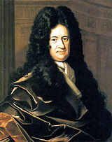
Binary Numbers
(studied by Gottfried Leibniz in 1679)
The binary system works in exactly the same way,
except that its place value is based on the number two.
In the binary system, we have the one's place, the two's place, the four's place, the eight's place, the sixteen's place, and so on.
Each place in the number represents two times (2X's) the place to its right.
Binary number system has a base, or radix, of 2. Binary numbers are composed of two symbols: 0 and 1.
Number Systems
Notes:
Problem Solving

Slide 9
Binary Numbers (cont.)
Decimal | Binary
0 | 0000
1 | 0001
2 | 0010
3 | 0011
4 | 0100
5 | 0101
6 | 0110
7 | 0111
8 | 1000
9 | 1001
10 | 1010
8 + 2 = 10
8 4 2 1
1 0 1 0
Considering the digits that has a value of 1 and adding it number marker on the top of each digits
Number Systems
Notes:
Problem Solving

Slide 10
Octal Numbers
The octal number system has a base, or radix, of 8. Octal numbers are composed of eight symbols: 0, 1, 2, 3, 4, 5, 6, and 7.
Number Systems
Notes:
Problem Solving

Slide 11
Hexadecimal Numbers
The hexadecimal number system has a base, or radix, of 16. Hexadecimal numbers are composed of sixteen symbols: 0, 1, 2, 3, 4, 5, 6, 7, 8, 9, A, B, C, D, E, and F.
Symbols A to F correspond to decimal numbers 10 to 15.
Number Systems
Notes:
Problem Solving

Slide 12
Conversion of the Number System
Binary to Decimal , Octal, Hexadecimal
Decimal to Binary, Octal, Hexadecimal
Octal to Decimal, Binary, Hexadecimal
Hexadecimal to Binary, Octal, Decimal
Number Systems
Notes:
Problem Solving

Slide 13
Binary to Decimal
Remember that Binary numbers are based on the radix of 2 while Decimal numbers are based on the radix of 10.
Remember also that binary will only be represented in 1s and 0s.
Steps in converting Binary to Decimal:
  Place a number marker on the top of the given digits, starting from 0 up the last given digits—starting from the right to determine the exponent to use.
  Consider all the 1s in the given digits and multiply it with the base number of the given digits (which is base 2) and raised it with power of the number corresponded in the number marker you placed on the top of the given digits.
Number Systems
Notes:
Problem Solving

Slide 14
Example: Binary to Decimal
Place the number marker on the top of the given digits, starting from the right, starting from 0 up to the last given digit on the left.
101010₂ = ?₁₀
= 101010
= 1*2⁵ + 1*2³ + 1*2¹
= 32 + 8 + 2
= 42₁₀
5 4 3 2 1 0
Number Systems
Notes:
Problem Solving

Slide 15
Example: Binary to Decimal
101.01₂ = ?₁₀
= 101.01
= 1*2² + 1*2⁰ + 1*2⁻²
= 4 + 1 + 0.25
= 5.25₁₀
If dealing with fraction in binary the marker will start at the right side of the decimal point and starting with the -1 up to the last given digit.
2 1 0 -1 -2
1*2⁻² will be converted into 1*2^{½} which results into 0.25 because you will be dividing 1 / 4 which comes from 1*2^{½}
Notes:
Problem Solving
101.012 = ?10
1 0 1 . 0 1 = 1*22 + 0*21 + 1*20 + 0*2-1 + 1*2-2
= 4 + 1 + 0.25
= 5.2510

Slide 16
Binary to Octal
Since one octal digit is equivalent to three binary digits, just group three binary digits, starting from the least significant bit (right side).
Append 0 to the most significant bit (left side), if the grouping does not have enough to form three binary digits.
In short, you must complete the grouping of three digits.
If you will be having a fraction (decimal point), append 0 to the least most significant bit (right side) of the given digits to complete the grouping of three bits.
Number Systems

Slide 17
Binary to Octal (cont.)
Steps in converting Binary to Octal:
  Group the given digits in three starting from the right side.
  If the grouping is not complete, place 0 to complete the grouping.
  Once you have grouped it into three digits, you starting converting the binary digits into decimal values following the concepts of binary digits (4, 2, 1) starting from the right.
Number Systems

Slide 18
Example: Binary to Octal
1101010₂ = ?₈
= 001 101 010
= 001 101 010
= 1 5 2₈
= 152₈
3rd group
2nd group
1st group
Add 0 to the left, to complete the grouping
4 2 1
4 2 1
4 2 1
Simply add all the number markers considering the binary digits that has 1 on it.
Number Systems
Notes:
Problem Solving

Slide 19
Example: Binary to Octal
1101.01₂ = ?₈
= 001 101 . 010
= 001 101 . 010
= 1 5 . 2₈
= 15.2₈
2nd group
1st group
1st group
Add 0 to the right, to complete the grouping for the fractional part of the given binary
4 2 1
4 2 1
4 2 1
Simply add all the number markers considering the binary digits that has 1 on it.
Number Systems
Notes:
Problem Solving

Slide 20
Binary to Hexadecimal
Since one hexadecimal digit is equivalent to four binary digits, just group four binary digits, starting from the least significant bit (right side).
Append 0 to the most significant bit (left side), if the grouping does not have enough to form four binary digits.
In short, you must complete the grouping of four digits.
If you will be having a fraction (decimal point), append 0 to the least most significant bit (right side) of the given digits to complete the grouping of three bits.
Number Systems

Slide 21
Binary to Hexadecimal (cont.)
Steps in converting Binary to Hexadecimal:
  Group the given digits in four starting from the right side.
  If the grouping is not complete, place 0 to complete the grouping.
  Once you have grouped it into three digits, you starting converting the binary digits into decimal values following the concepts of binary digits (8, 4, 2, 1) starting from the right.
Number Systems

Slide 22
Example: Binary to Hexadecimal
Simply add all the number markers considering the binary digits that has 1 on it.
1101010₂ = ?₁₆
= 0110 1010
= 0110 1010
= 6 A₁₆
= 6A₁₆
2nd group
1st group
Add 0 to the left, to complete the grouping
8 4 2 1
8 4 2 1
Number Systems
Notes:
Problem Solving

Slide 23
Example: Binary to Hexadecimal
Simply add all the number markers considering the binary digits that has 1 on it.
1101.01₂ = ?₁₆
= 1101 . 0100
= 1101 . 0100
= D . 4₁₆
= D.4₁₆
1st group
1st group
Add 0 to the left, to complete the grouping
8 4 2 1
8 4 2 1
Number Systems
Notes:
Problem Solving

Slide 24
Decimal to Binary
Converting a decimal number to a binary number is done by successively dividing the decimal number by 2 on the left side of the radix.
If you will have a fractional part of the given decimal, successively multiplying the decimal number by 2 on the right side of the radix.
Number Systems

Slide 25
Decimal to Binary (cont.)
Steps in converting Decimal to Binary:
  Divide the given decimal number with the base number you are converting it to, which is 2.
  Whatever the answer you will get in the division will be divided again with the base (2) until you cannot divide the answer anymore with 2.
  The remainder that you will get will be the one you consider as your converted answer.
Number Systems

Slide 26
Example: Decimal to Binary
Remainder of the division, will only have two values since it is in base 2, meaning you can only have 1 or 0 as a remainder.
6₁₀ = ?₂
= 110₂
= 6/2 0
= 3/2 1
= 1/2 1
= 0/2
remainder
In reading the answer, you should read it upward.
Number Systems
Notes:
Problem Solving

Slide 27
Example: Decimal to Binary
6.625₁₀ = ?₂
= 110.101₂
= .625*2
= 1.25*2 1
= 0.5*2 0
= 1.0 1
You will be multiplying only the decimal numbers with base 2 until you reach 0 in the decimal place.
In reading the answer, you should read it downward.
Stop here, because it is already 0
Number Systems
Notes:
Problem Solving

Slide 28
Decimal to Octal
Converting a decimal number to an octal number is done by successively dividing the decimal number by 8 on the left side of the radix.
If you will have a fractional part of the given decimal, successively multiplying the decimal number by 8 on the right side of the radix.
Number Systems

Slide 29
Decimal to Octal (cont.)
Steps in converting Decimal to Octal:
  Divide the given decimal number with the base number you are converting it to, which is 8.
  Whatever the answer you will get in the division will be divided again with the base (8) until you cannot divide the answer anymore with 8.
  The remainder that you will get will be the one you consider as your converted answer.
Number Systems

Slide 30
Example: Decimal to Octal
66₁₀ = ?₈
= 102₈
= 66/8 2
= 8/8 0
= 1/8 1
= 0/8
Remainder of the division, will only have 0-7 values since it is in base 8
remainder
In reading the answer, you should read it upward.
Number Systems
Notes:
Problem Solving

Slide 31
Example: Decimal to Octal
66.625₁₀ = ?₈
= 102.5₈
= .625*8
= 5. 0 5
You will be multiplying only the decimal numbers with base 8 until you reach 0 in the decimal place.
In reading the answer, you should read it downward.
Stop here, because it is already 0
Number Systems
Notes:
Problem Solving

Slide 32
Decimal to Hexadecimal
Converting a decimal number to a hexadecimal number is done by successively dividing the decimal number by 16 on the left side of the radix
If you will have a fractional part of the given decimal, successively multiplying the decimal number by 16 on the right side of the radix.
Number Systems

Slide 33
Decimal to Hexadecimal (cont.)
Steps in converting Decimal to Hexadecimal:
  Divide the given decimal number with the base number you are converting it to, which is 16.
  Whatever the answer you will get in the division will be divided again with the base (16) until you cannot divide the answer anymore with 16.
  The remainder that you will get will be the one you consider as your converted answer.
Number Systems

Slide 34
Example: Decimal to Hexadecimal
Remainder of the division, will only have 0-9, A-F values since it is in base 16
286₁₀ = ?₁₆
= 11E₁₆
= 286/16 14
= 17/16 1
= 1/16 1
= 0/16
In reading the answer, you should read it upward.
The value 14 should be converted to hexadecimal format
remainder
Number Systems
Notes:
Problem Solving

Slide 35
Example: Decimal to Hexadecimal
286.625₁₀ = ?₁₆
= 11E.A₁₆
= .625*16
= 10.0 10
You will be multiplying only the decimal numbers with base 8 until you reach 0 in the decimal place.
In reading the answer, you should read it downward.
Stop here, because it is already 0
Number Systems
Notes:
Problem Solving

Slide 36
Octal to Decimal
Remember that Octal numbers are based on the radix of 8 while Decimal numbers are based on the radix of 10.
Remember also that Octal will only be represented with value 0-7.
Steps in converting Octal to Decimal:
  Place a number marker on the top of the given digits, starting from 0 up the last given digits—starting from the right to determine the exponent to use.
  Considering all the given digits, multiply it with the base number of the given digits (which is base 8) and raised it with power of the number corresponded in the number marker you placed on the top of the given digits.
Number Systems
Notes:
Problem Solving

Slide 37
Example: Octal to Decimal
Place the number marker on the top of the given digits, starting from the right, starting from 0 up to the last given digit on the left.
761₈ = ?₁₀
= 761
= 7*8² + 6*8¹ + 1*8⁰
= 56 + 48 + 1
= 105₁₀
2 1 0
Number Systems
Notes:
Problem Solving

Slide 38
Example: Octal to Decimal
1*2⁻² will be converted into 1*2^{½} which results into 0.25 because you will be dividing 1 / 4 which comes from 1*2^{½}
761.18₈ = ?₁₀
= 761.15
= 7*8² + 6*8¹ + 1*8⁰ ⁺ 1*8⁻¹ + 8*8⁻²
= 448 + 48 + 1 +0.125+0.125
= 497.25₁₀
If dealing with fraction in octal the marker will start at the right side of the decimal point and starting with the -1 up to the last given digit.
2 1 0 -1 -2
Number Systems
Notes:
Problem Solving

Slide 39
Octal to Binary
Since one octal digit is equivalent to three binary digits, just convert the individual octal digit into three binary digits.
Steps in converting Octal to Binary:
  Convert each of the given octal number by simply using the concept of (4, 2, 1).
  Place a binary 1 to correspond the given octal number.
Number Systems
Notes:
Problem Solving

Slide 40
Example of Octal to Binary
Simply add all the number markers considering the binary digits that has 1 on it, to get the octal number given.
761₈ = ?₂
= 7 111
= 6 110
= 1 001
= 111 110 001₂
4 2 1
4 2 1
4 2 1
Number Systems
Notes:
Problem Solving

Slide 41
Example of Octal to Binary
761.25₈ = ?₂
= 111 110 001 . 010 101
= 111 110 001.010101₂
4 2 1
4 2 1
4 2 1
4 2 1
4 2 1
7 6 1
2 5
Number Systems
Notes:
Problem Solving

Slide 42
Octal to Hexadecimal
When converting an octal digit to a hexadecimal digit, you must first convert the octal number to binary number and group it by four and convert the grouped digits to hexadecimal by using the concept of (8, 4, 2, 1).
If the digits is not enough to form a grouping of four then append 0 on the left side of the digits.
If the given octal have fraction, then append 0 on the right side of the given digits.
Number Systems

Slide 43
Octal to Hexadecimal (cont.)
Steps in converting Octal to Hexadecimal:
  Convert the octal digits in binary by considering each given digits and represent it in binary using the concept (4, 2, 1).
  Once it is in binary, that’s the time you convert the binary into hexadecimal, by grouping it into four.
Number Systems

Slide 44
Example: Octal to Hexadecimal
761₈ = ?₁₆
= 111 110 001
= 0001 1111 0001
= 1F1₁₆
7 6 1
1 F 1
Number Systems

Slide 45
Example: Octal to Hexadecimal
761.75₈ = ?₁₆
= 111 110 001 . 111 101
= 0001 1111 0001 . 1111 0100
= 1F1.F4₁₆
7 6 1
7 5
1 F 1
F 4
Number Systems

Slide 46
Hexadecimal to Binary
Since one hexadecimal digit is equivalent to four binary digits, just convert the individual hexadecimal digit into four binary digit
Number Systems
Notes:
Problem Solving
Since one hexadecimal digit is equivalent to four binary digits, just convert the individual hexadecimal digit into four binary digit

Slide 47
Example: Hexadecimal to Binary
7AE3₁₆ = ?₂
= 7 0111
A 1010
E 1110
3 0011
= 0111 1010 1110 0011₂
Number Systems

Slide 48
Example: Hexadecimal to Binary
7AE.3₁₆ = ?₂
= 7 0111
A 1010
E 1110
3 0011
= 0111 1010 1110 . 0011₂
Number Systems

Slide 49
Hexadecimal to Octal
When converting an hexadecimal digit to an octal digit, you must first convert the hexadecimal number to binary number and group it by three and convert the grouped digits to octal by using the concept of (4, 2, 1).
If the digits is not enough to form a grouping of three then append 0 on the left side of the digits.
If the given hexadecimal have fraction, then append 0 on the right side of the given digits.
Number Systems

Slide 50
Hexadecimal to Octal (cont.)
Steps in converting Hexadecimal to Octal:
  Convert the hexadecimal digits in binary by considering each given digits
  Once converted to binary group the binary into three and using the concept (4, 2, 1).
Number Systems

Slide 51
Example: Hexadecimal to Octal
7AE3₁₆ = ?₈
= 7 0111
A 1010
E 1110
3 0011
= 0 111 101 011 100 011₂
= 75343₈
7 5 3 4 3
Number Systems

Slide 52
Example: Hexadecimal to Octal
7AE.3₁₆ = ?₈
= 7 0111
A 1010
E 1110
3 0011
= 0111 1010 1110 . 0011₂
= 011 110 101 110 . 001 100₂
= 3656.14₈
3 6 5 6 1 4
Number Systems

Slide 53
Hexadecimal to Decimal
Each hexadecimal position is weighted with a power of 16.
Digits on the left side of the radix point has a positive exponent while on the right side of the radix point has a negative exponent.
Converting a hexadecimal number to a decimal number is done by successively multiplying the decimal number by 16 on the left side of the radix
If you will have a fractional part of the given decimal, successively multiplying the decimal number by 16 on the right side of the radix.
Number Systems

Slide 54
Hexadecimal to Decimal (cont.)
Steps in converting Hexadecimal to Decimal:
  Place a number marker on the top of the given number for determining the exponent to be used.
  Get the individual digit and multiply it by the base number (16) and raised it with the exponent corresponds to the number marker you place on each digit, then to the addition operation.
Number Systems

Slide 55
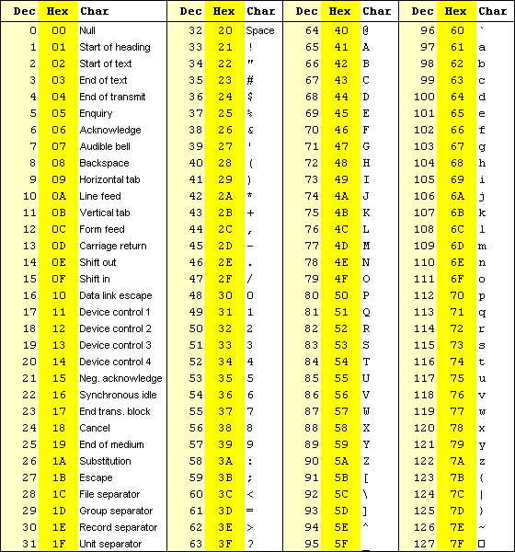
Introduction to Computer Programming <number>

Slide 56
Example: Hexadecimal to Decimal
286.A₁₆ = ?₁₀
= 286.A
= 2*16² + 8*16¹ + 6*16⁰ + A*16⁻¹
= 646. 625₁₀
2 1 0 -1
Number Systems
Notes:
Problem Solving

Slide 57
Example: Hexadecimal to Decimal
286A₁₆ = ?₁₀
= 286A
= 2*16³ + 8*16² + 6*16¹ + A*16⁰
= 10346₁₀
3 2 1 0
Number Systems
Notes:
Problem Solving

Slide 58
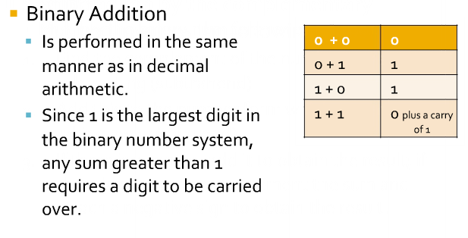
Binary Addition

Slide 59
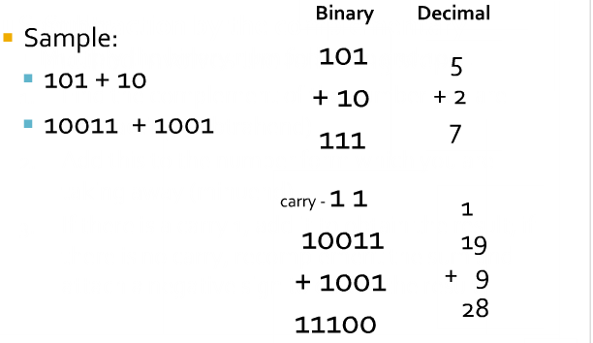
Binary Addition
Introduction to Computer Programming <number>

Slide 60
Binary Addition
Two 1-bit values
A | B | A + B
0 | 0 | 0
0 | 1 | 1
1 | 0 | 1
1 | 1 | 10
“two”
pp. 36-38

Slide 61
Binary Addition
Two n-bit values
  Add individual bits
  Propagate carries
  E.g.,
1
1
10101 21
+ 11001 + 25
101110 46

Slide 62
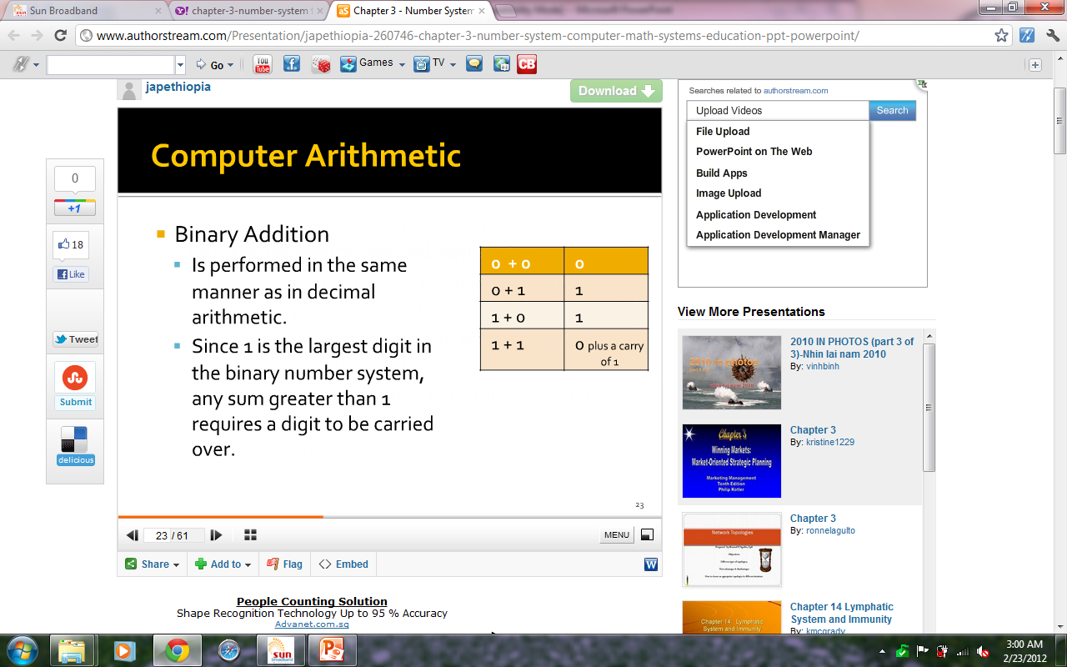
Binary Addition
Introduction to Computer Programming <number>

Slide 63
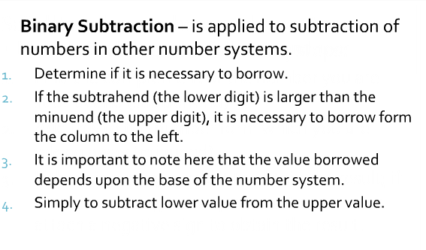
Binary Subtraction
Introduction to Computer Programming <number>

Slide 64
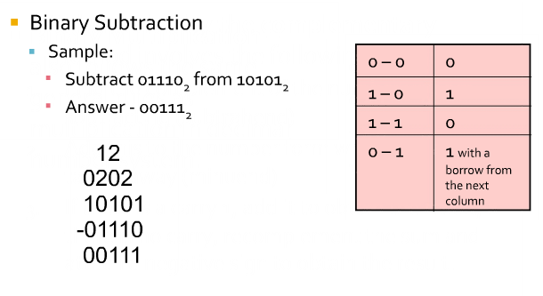
Binary Subtraction
Introduction to Computer Programming <number>

Slide 65
Thank you

